Slide 1
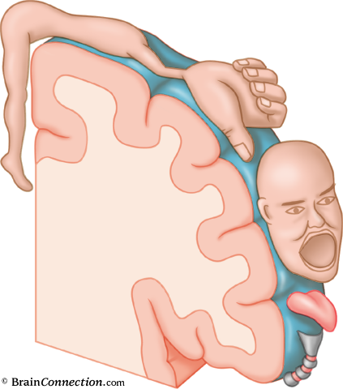
Action potential
http://outreach.mcb.harvard.edu/animations/actionpotential_short.swf

Slide 2
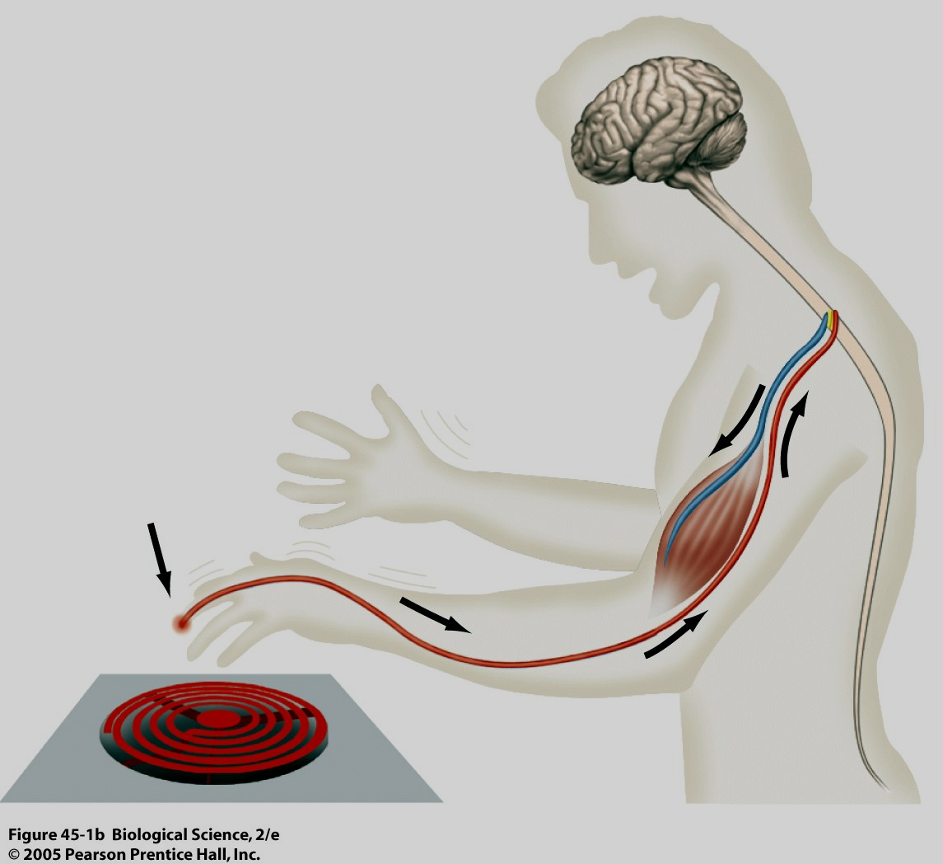

Slide 3
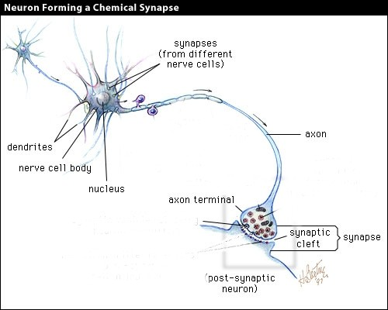

Slide 4

Propagation of neuronal excitation from dendrites to the axon
dendrites
soma
axon with an axon collateral

Slide 5
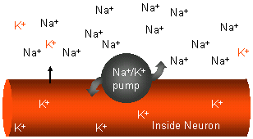
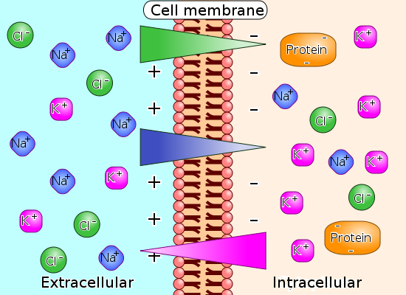
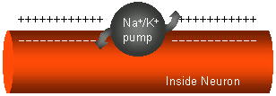
INTRA- & EXTRA-CELLULAR ION CONCENTRATIONS

Slide 6
Typical Mammalian Intracellular and Extracellular Ion Concentrations
^{ION} | CELL (mM) | Blood (mM)
K⁺ | 139 | 4
Na⁺ | 12 | 145
Cl⁻ | 4 | 116
Ca²⁺ | <.0002 | 1.8
Proteins (X⁻) | 138 | 9
Mg²⁺ | 0.8 | 1.5

Slide 7
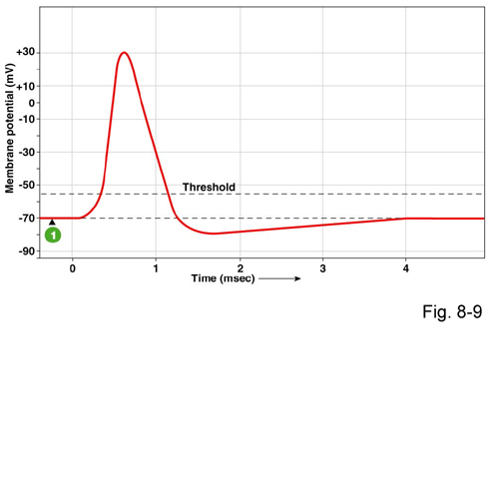
ACTION POTENTIAL
rising phase
depolarization
falling phase
repolarization
stimulation
hyperpolarization
Action potential (nerve impulse) occures at excitable tissues
(mostly neuron fibers or muscle cells) when graded potential reaches the threshold (gate threshold) – firing level.
It is all-or-none (it happens or do not happen).

Slide 8
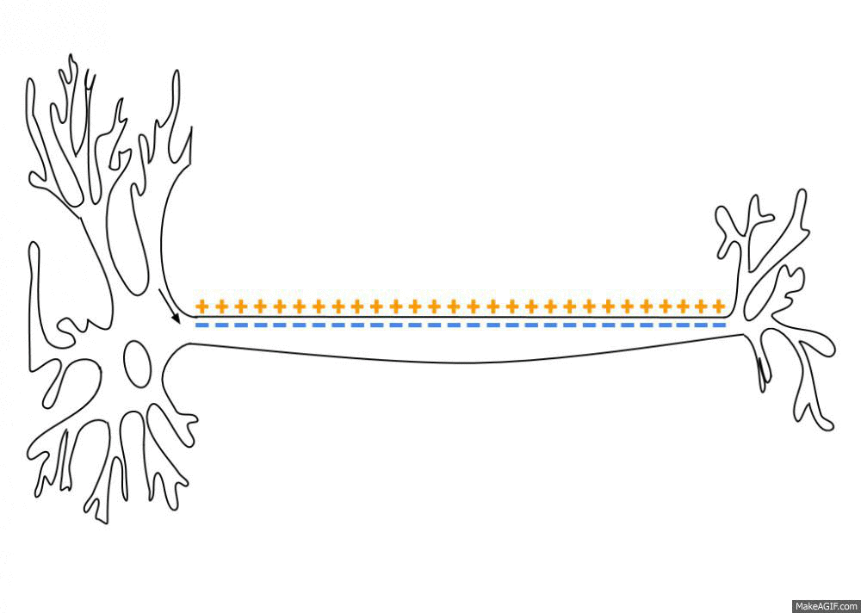

Slide 9
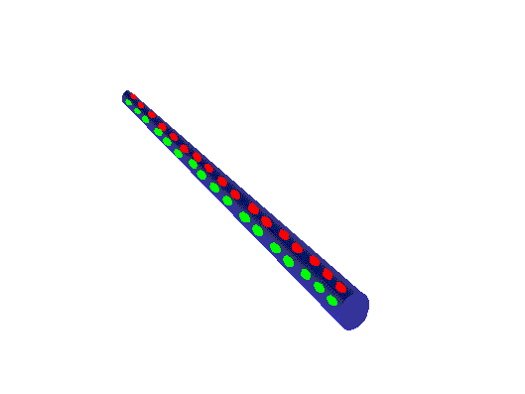
Action Potentials
How neurons conduct impulses

Slide 10
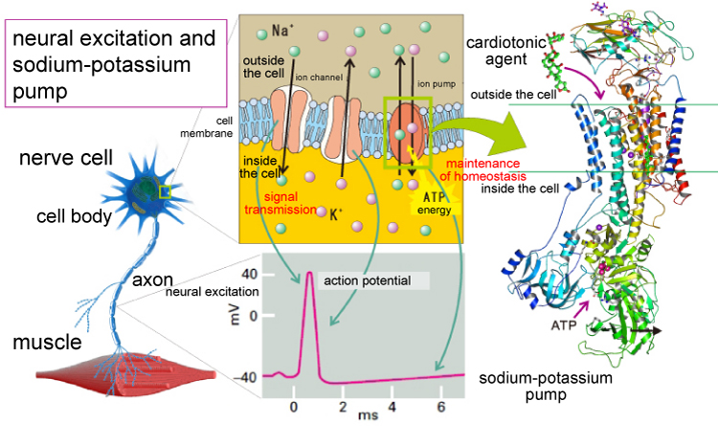

Slide 11
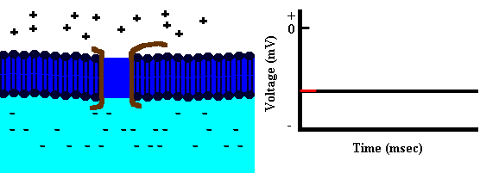
Depolarization

Slide 12
Repolarization

Slide 13
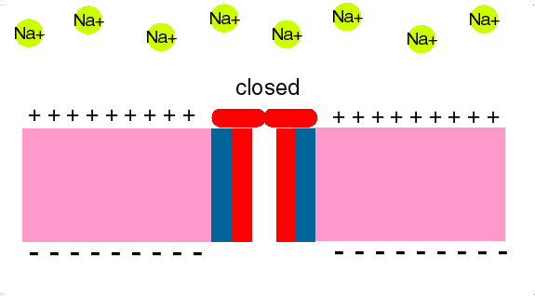

Slide 14
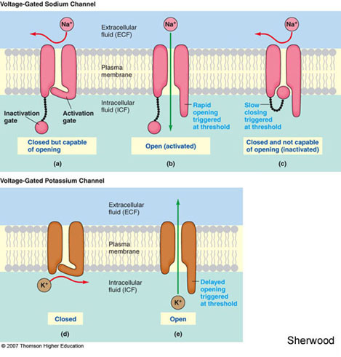
Scheme of Na voltage gated channel and K voltage gated channel involved in processing of action potential

Slide 15
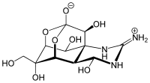
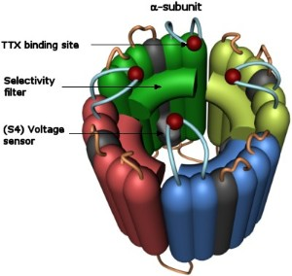
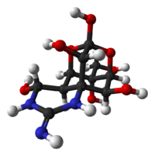
Tetrodotoxin

Slide 16
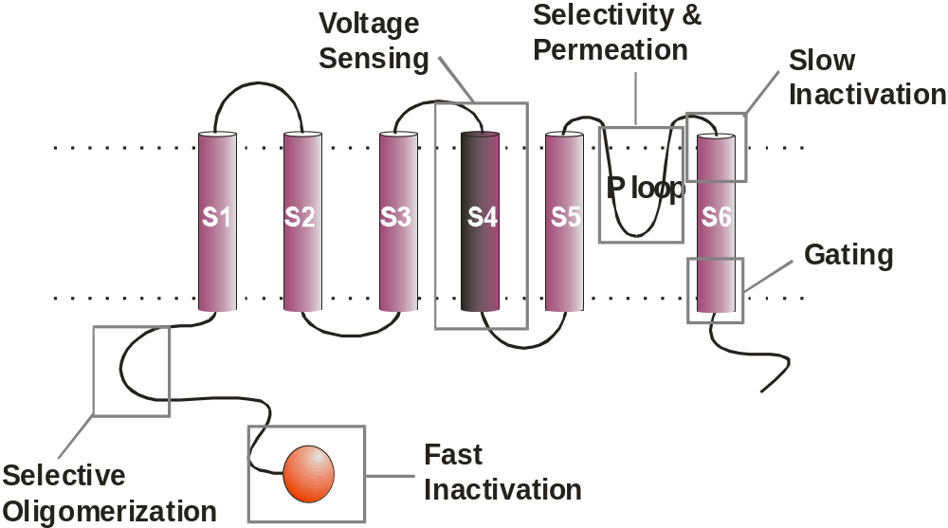
Structure-Function Relations in a Voltage-Dependent Channel

Slide 17
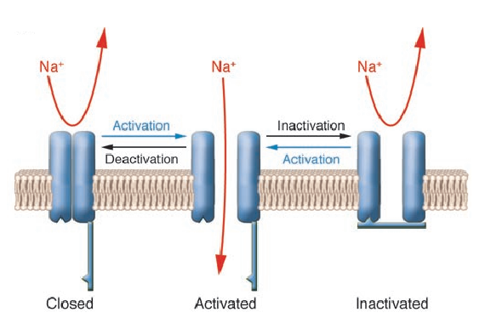
Activation-Inactivation-Deactivation

Slide 18
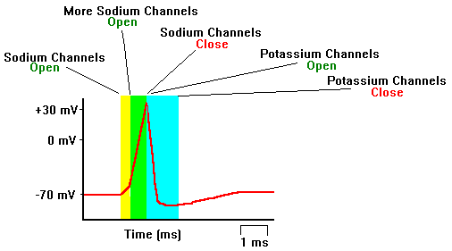
Na⁺ channels in excitable membranes

Slide 19
Depolarization

Slide 20
Repolarization

Slide 21
Course of the Action Potential
The action potential begins with a partial depolarization (e.g. from firing of another neuron ) [A].
When the excitation threshold is reached there is a sudden large depolarization [B].
This is followed rapidly by repolarization [C] and a brief hyperpolarization [D].
There is a refractory period immediately after the action potential where no depolarization can occur [E]
+40
Membrane potential (mV)
[B]
[C]
0
[A]
[E]
[D]
excitation threshold
-70
0
1
2
3
Time (msec)

Slide 22
Myelination
Most mammalian axons are myelinated.
The myelin sheath is provided by oligodendrocytes and Schwann cells.
Myelin is insulating, preventing passage of ions over the membrane.

Slide 23
Saltatory Conduction
Myelinated regions of axon are electrically insulated.
Electrical charge moves along the axon rather than across the membrane.
Action potentials occur only at unmyelinated regions: nodes of Ranvier.
Myelin sheath
Node of Ranvier

Slide 24
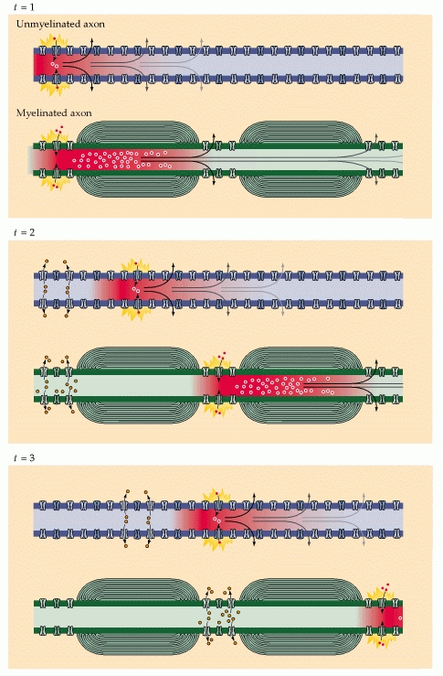
Conductance speed in myelinated and unmyelinated neurons:
Myelin: upto 150 meters/second
No myelin: between 0.5 and 10 meters/second

Slide 25
Speed of Conduction
Myelination
  Myelinated fibers conduct action potentials faster
Axon diameter
  Larger axons conduct faster
Temperature
  Warm membrane proteins react faster
    Cold (ice) used to block pain sensation
24 Oct. 2012
ActionPotentials.ppt

Slide 26
Speed of Conduction
Large myelinated fibers
  100-150 m/sec
  Peripheral sensory & motor axons
Thin unmyelinated fibers
  ~ 1 m/sec
  Short axons in gray matter of CNS
24 Oct. 2012
ActionPotentials.ppt

Slide 27
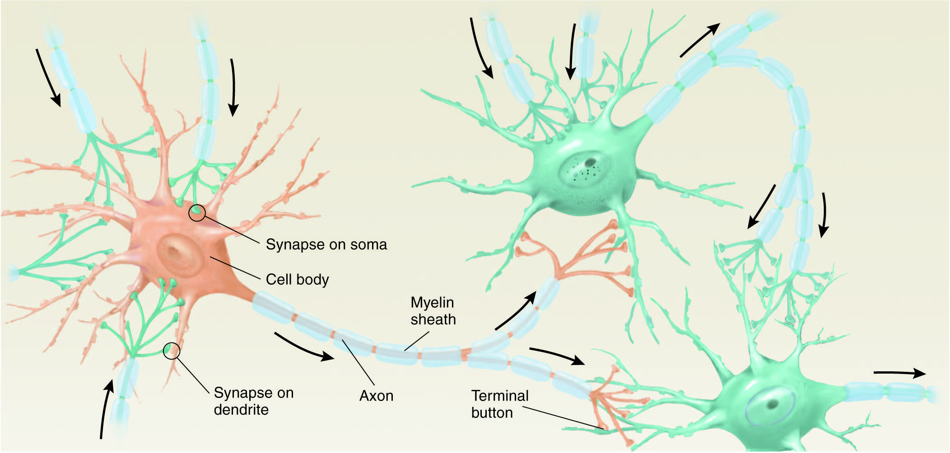
The synapse
The junction between the terminal button of one neuron
and the membrane of another neuron (~20 nm)
Presynaptic neuron vs. Postsynaptic neuron

Slide 28
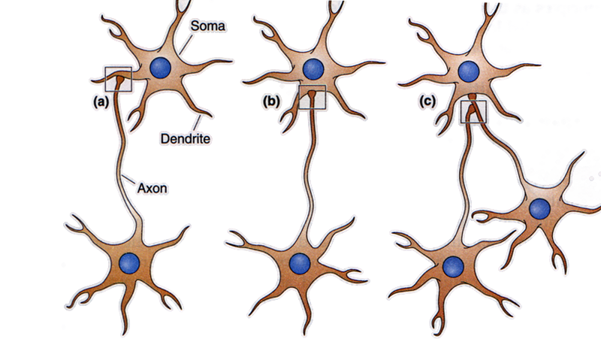
Types of synaptic connections
Axo-dendritic
Axo-somatic
Axo-axonic

Slide 29
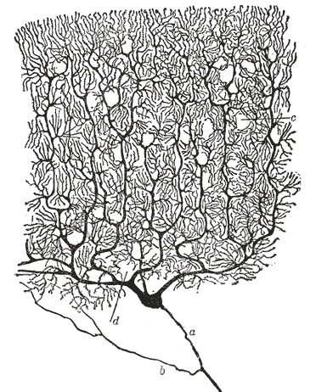
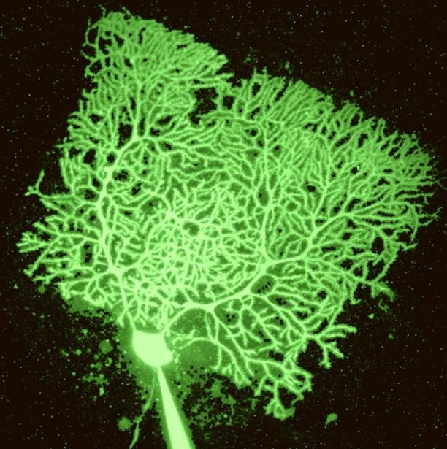
A single cell can receive synaptic input from up to ~100,000 !!!
Purkinje cell in cerebellum
150,000!! contacts

Slide 30
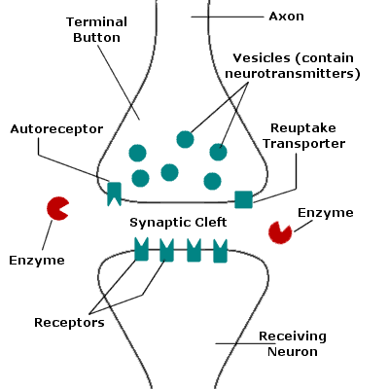
Synapse
axon of presynaptic
neuron
dendrite of
postsynaptic
neuron
bipolar.about.com/library

Slide 31
Synapse
a synapse can be excitatory or inhibitory
arrival of activity at an excitatory synapse depolarizes the local membrane potential of the postsynaptic cell and makes the cell more prone to firing
arrival of activity at an inhibitory synapse hyperpolarizes the local membrane potential of the postsynaptic cell and makes it less prone to firing
the greater the synaptic strength, the greater the depolarization or hyperpolarization

Slide 32
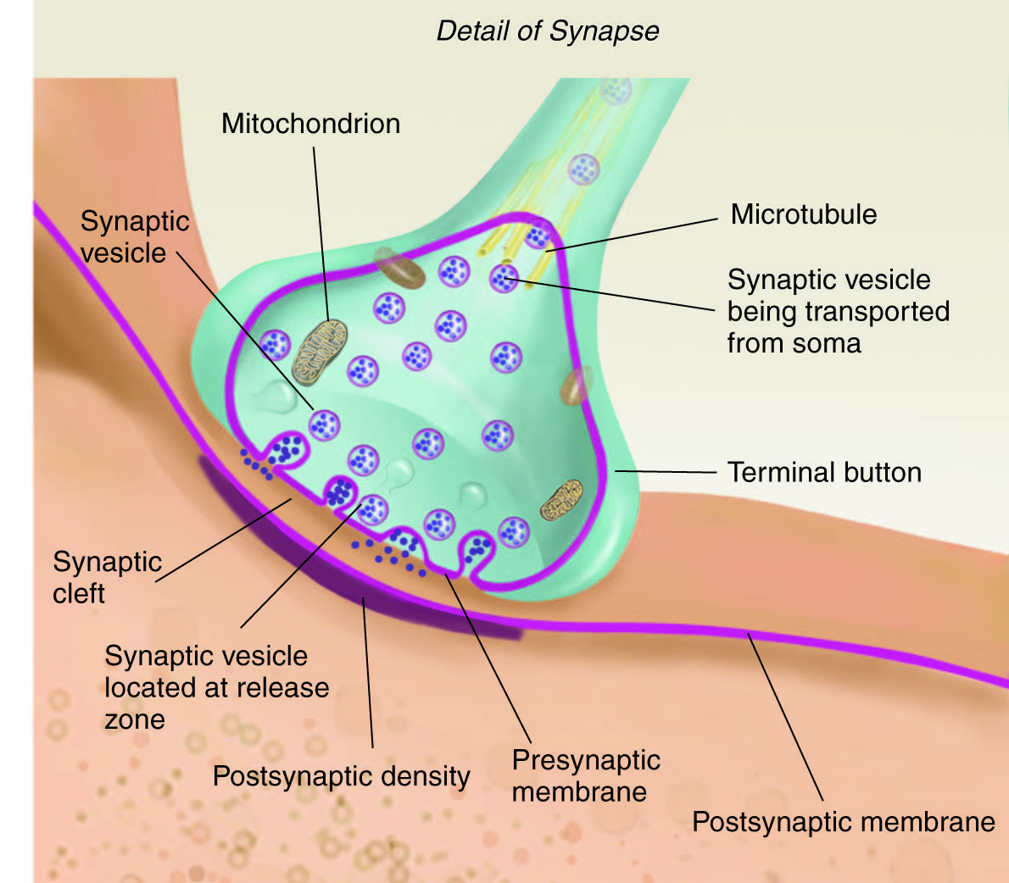
Terminal button (structure)

Slide 33
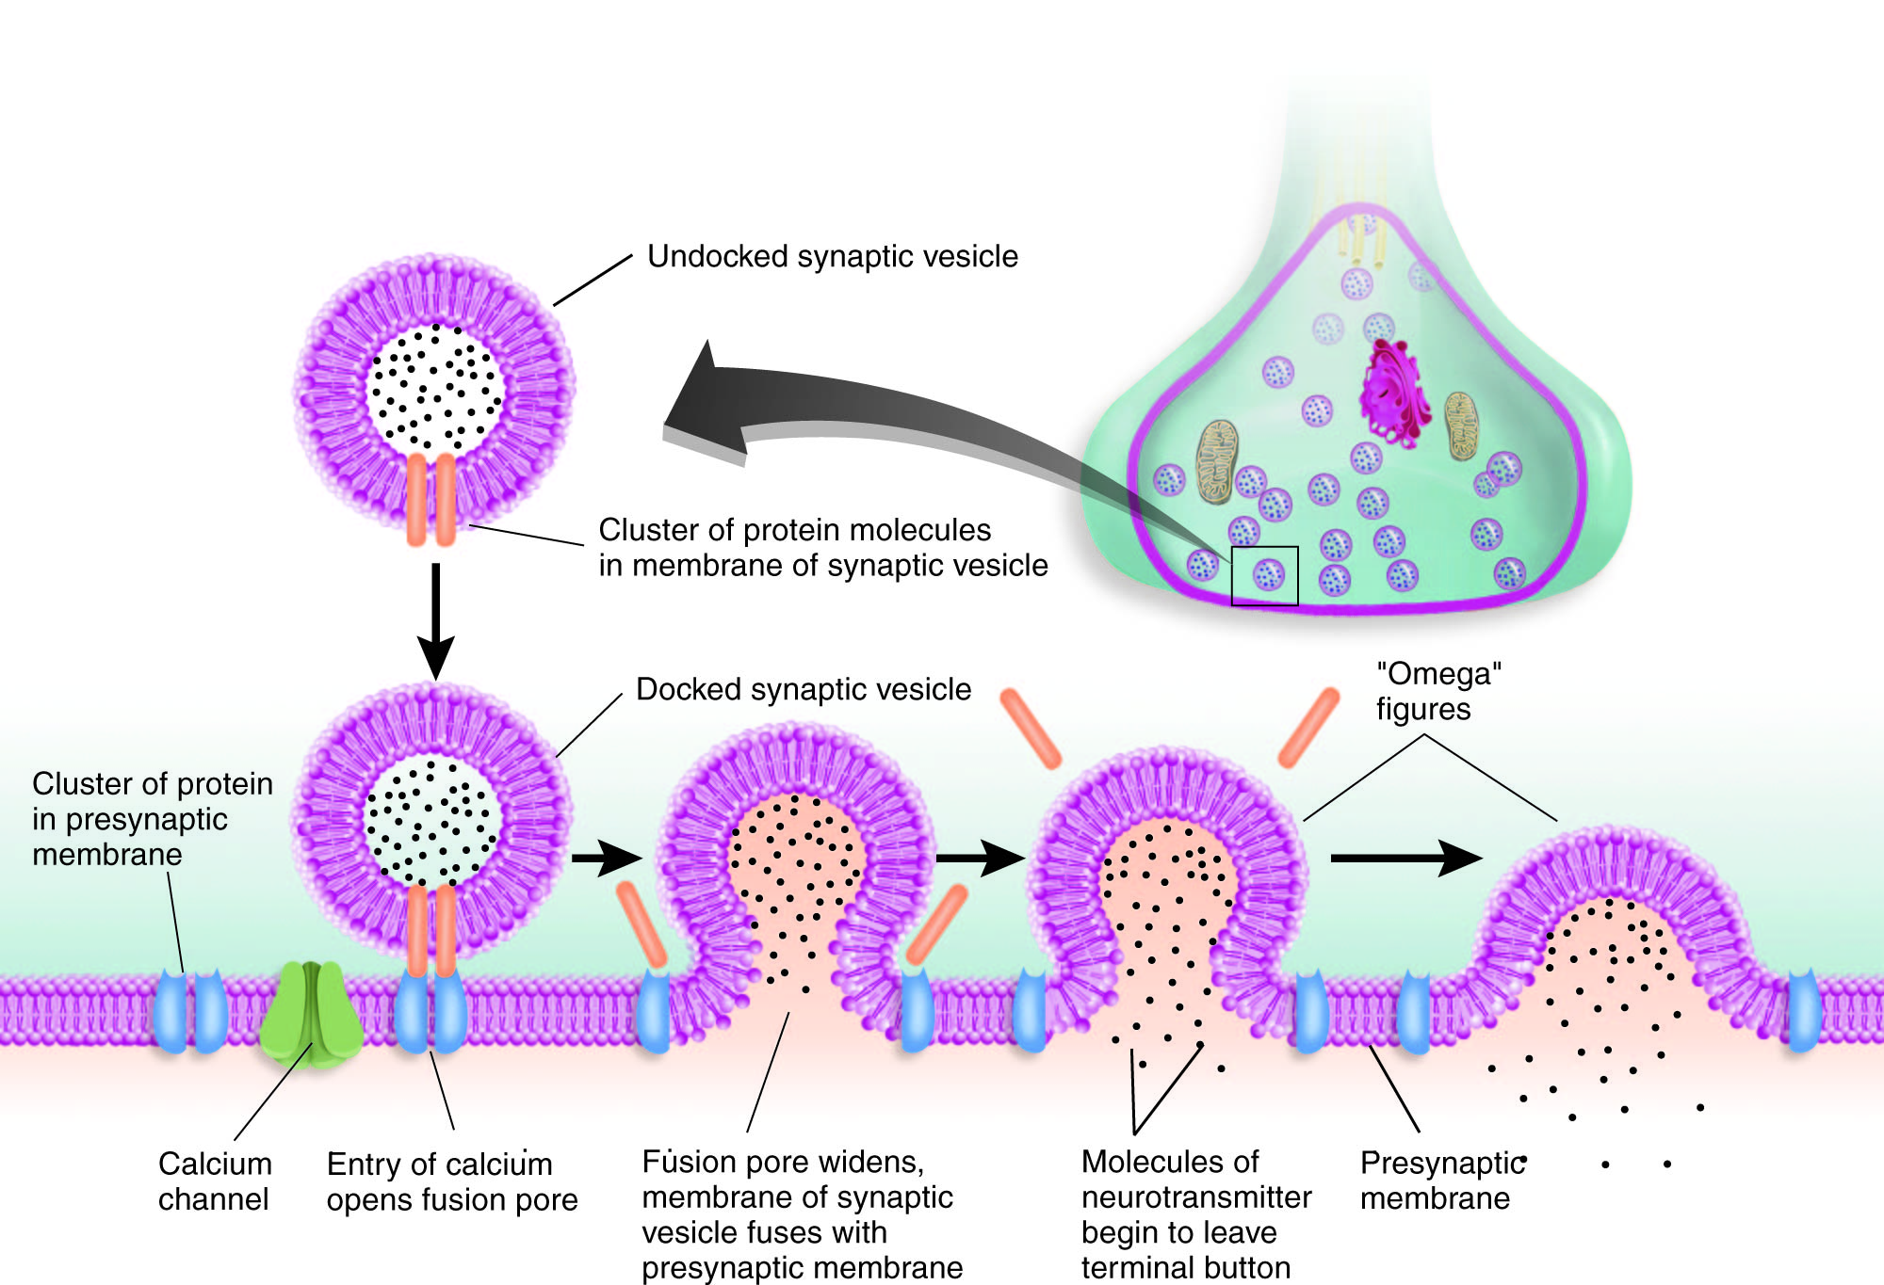
Each action potential → release of a fixed # of vesicles
Exocytosis - Followed by recycling
Without Ca2+ - there will be no release of neurotransmitter

Slide 34
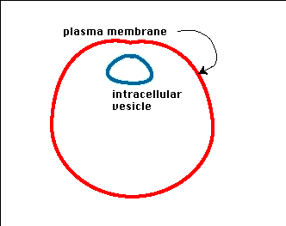
Exocytosis

Slide 35
Stages in the process of neurotransmitter release:
Docking vesicles containing neurotransmitters
An action-potential arrives, and causes voltage-gated Calcium-channels to open (Ca²⁺ enters the cell)
Ca²⁺ causes fusion of the vesicles with the cell membrane
Neurotransmitter in vesicle is expelled (exocytosis)
Vesicle membrane either fuses with cell membrane or closes back inside the cell

